Slide 1
TWITTER DATA ANALYTICS
Project By
1. Archana Reddy Basani
2. Mourya Praharsha Bobbili
3. Dileep Kumar Durgam

Slide 2
OBJECTIVE
Collect tweets using Twitter’s streaming APIs
Extract all the hashtags and URLs in the tweets
Run the word count example in Apache Hadoop and Apache Spark on the extracted Hashtags and URLs and collect the output from Hadoop
Collected twitter data (tweets) and developed the environment IntelliJ for Scala and Spark development.
Queries has been written and displayed as per the analysis.
Explanation of the ten queries and their outputs (captured screenshots) are documented.

Slide 3
Design Steps
In our undertaking, we utilized IntelliJ for Scala and Spark improvement. IntelliJ Scala blend is the best, free setup for Scala and Spark improvement.
Also, by utilize Spark APIs make Scala question and import Spark shakes as library conditions in IntelliJ lastly add some Spark API calls to the made protest.
Presently IntelliJ for Scala and Spark improvement condition is setup and we are prepared to actualize distinctive questions (Spark RDDs and Data frames) on our gathered stream of tweets for examination.
In this increment of project, we have taken the JSON file from the first phase and stored it in the form of Main table and queries are written in the SQL language for the extraction of the outputs and hash table is assigned for the output designed.
Ten queries are written in the SQL language and executed in the SCALA code which was written for execution.

Slide 4
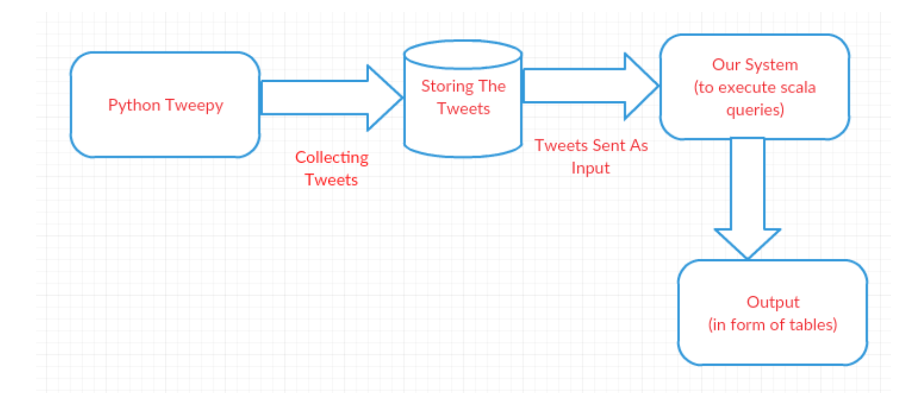
ARCHITECTURE

Slide 5
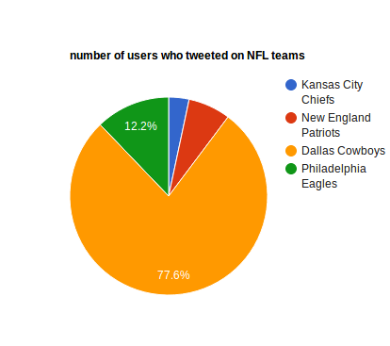
OUTPUT
QUERY-1
Number of Users who tweeted on NFL teams

Slide 6
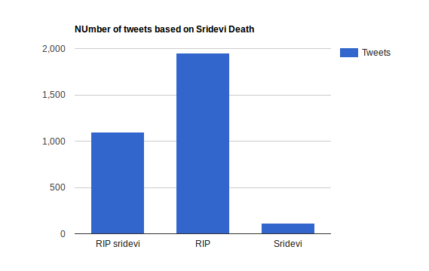
OUTPUT
QUERY-2
Number of tweets based on Sridevi death

Slide 7
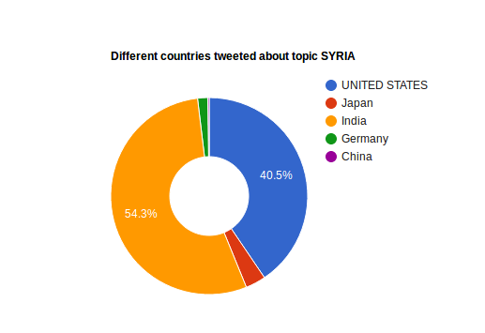
OUTPUT
QUERY-3
Different countries tweeted about topic SYRIA

Slide 8
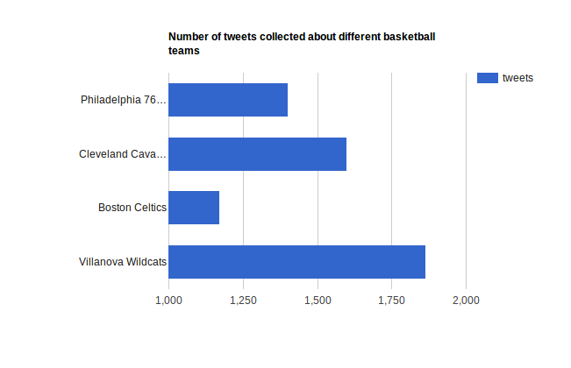
OUTPUT
QUERY-4
Number of tweets collected about different basketball teams.

Slide 9
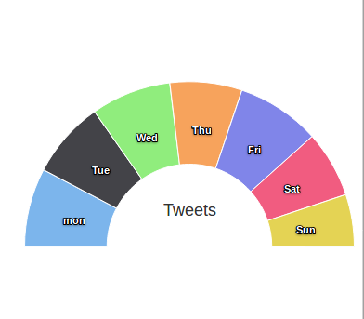
OUTPUT
QUERY-5
Number of tweets per day represented in semi-doughnut

Slide 10
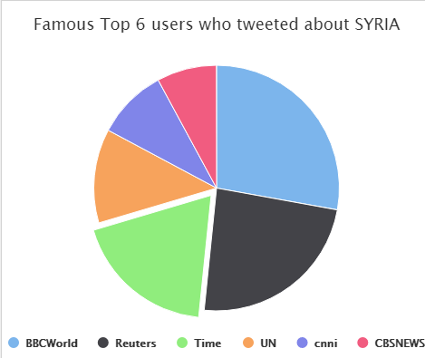
OUTPUT
QUERY-6
Famous Top -6 users who tweeted about SYRIA

Slide 11
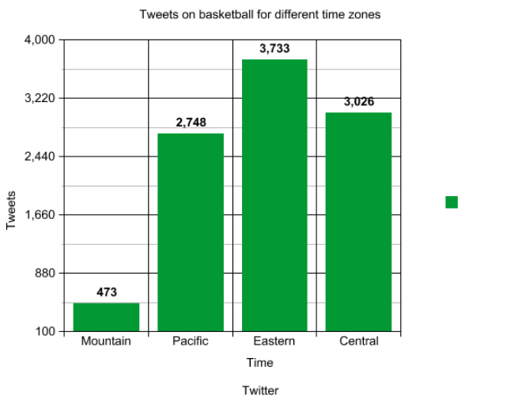
OUTPUT
QUERY-7
Tweets on basketball for different time zones

Slide 12
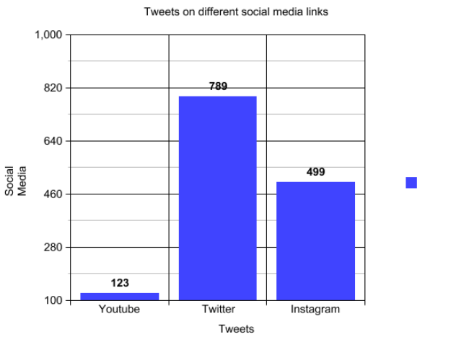
OUTPUT
QUERY-8
Tweets on different social media links

Slide 13
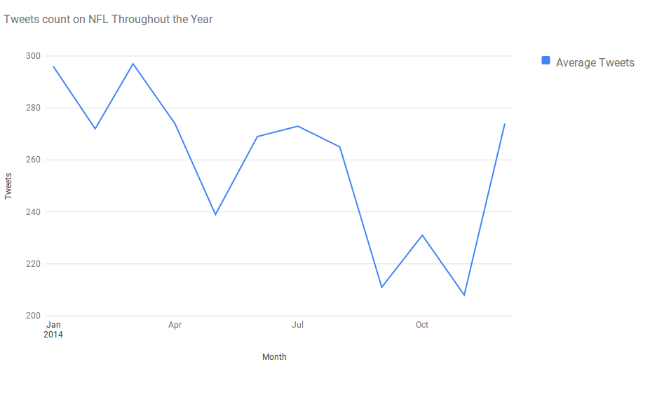
OUTPUT
QUERY-9
Tweets count on NFL through the year

Slide 14
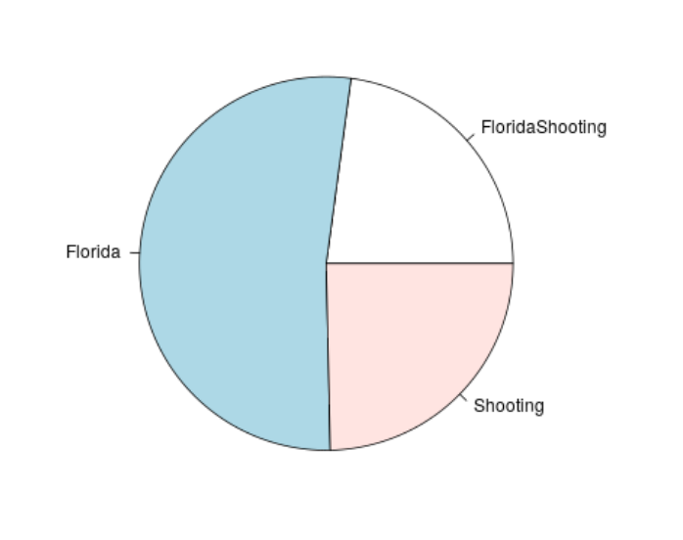
OUTPUT
QUERY-10
Number of tweets for the different hashtags “Floridashooting”, “Florida”,“Shooting” represented in piechart.

Slide 15
YOUTUBE LINK
https://youtu.be/EO0FHjLIIRk

Slide 16


